Slide 1
Predicting Sepsis using GLMs
Joe and the Joes

Slide 2
Problem Statement
Clinical standard is time consuming blood cultures, low resolution for diagnosis
Rapid increase of mortality rate in delayed diagnosis
Demographic risk comes down to the doctor to account for

Slide 3
Physiological Background
Sepsis
To be diagnosed with sepsis, you must exhibit at least two of the following symptoms:
Body temperature above 101 F (38.3 C) or below 96.8 F (36 C)
Heart rate higher than 90 beats a minute
Respiratory rate higher than 20 breaths a minute
Probable or confirmed infection
Sepsis induces autonomic nervous system change
“Circulating endotoxin impairs the sympathetic regulation of the cardiovascular system”
(http://www.mayoclinic.org/diseases-conditions/sepsis/basics/symptoms/con-20031900)

Slide 4
Approach
In order to accurately predict sepsis, we selected covariates that:
fit real world modeling (Made physiological sense/can be supported through scientific research)
Numerically rigorous (highest effect on improving linear model)
Qualitatively resolvable histograms for septic / nonseptic patients
A stepwise glm (function: stepwiseglm) was implemented:
Sequentially adds parameters, combinations and squares to see how metrics of model change

Slide 5
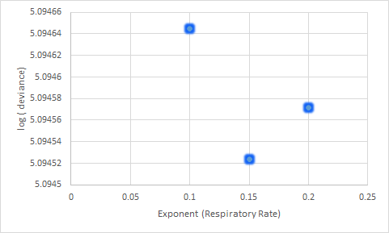
Choosing functional form of Data
General form: (waveform).^p
Only one parameter, can amplify either high or low data points
Powers for each waveform were determined experimentally (trial-and-error)
Minimizing deviance and sum-standard-error as a function of power

Slide 6
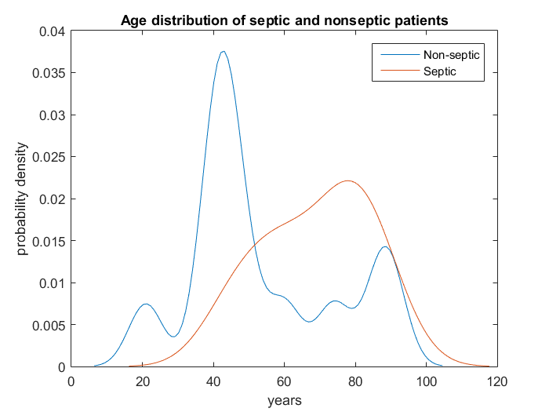
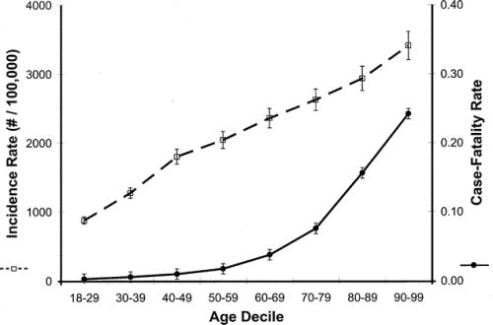
Age
Makes physiological sense
“The cumulative 24-yr age-specific incidence of sepsis increased exponentially across all age deciles, from 29.6 cases per 100,000 individuals in the 18–29 age decile to 2,422.3 cases per 100,000 in the 90–99 age decile.”
The effect of age on the development and outcome of adult sepsis *
Martin, Greg S. MD, MSc; Mannino, David M. MD; Moss, Marc MD

Slide 7
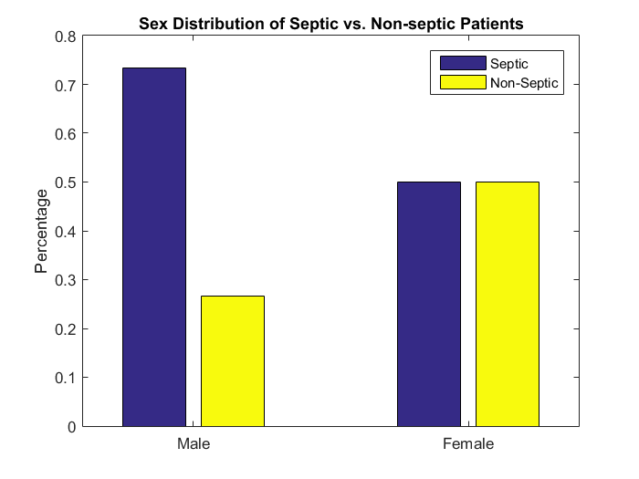
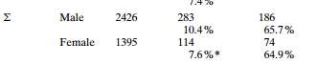
Sex
Makes physiological sense
“There is increasing evidence that sex hormones not only modulate the immune and cardiovascular responses following trauma or sepsis”
“Metabolic modulators following trauma sepsis: Sex hormones” Hsieh, Ya-Ching PhD; Frink, Michael MD; Choudhry, Mashkoor A. PhD; Bland, Kirby I. MD; Chaudry, Irshad H. PhD)
Incidence and mortality of severe sepsis in surgical intensive care patients: the influence of patient gender on disease process and outcome
Wichmann, M W; Inthorn, D; Andress, H -j; Schildberg, F W. Intensive Care Medicine26.2 (Mar 2000): 167-72.

Slide 8
Comorbidities
Comorbidities for heart/cardio/other problems:
Selective in a general population
HOWEVER
Not selective within the sample set of ICU patients
Therefore we omitted these parameters from the static model
Notes:
While it makes sense for there to be a correlation between comorbidities (cardiac, respiratory, and other) and sepsis with a sample taken from the total population, our model is built from ICU patient data and is intended to be used to predict sepsis in ICU patients. Therefore, the correlation of cormodities and sepsis decreases significantly and was not used as a parameter in our model.

Slide 9
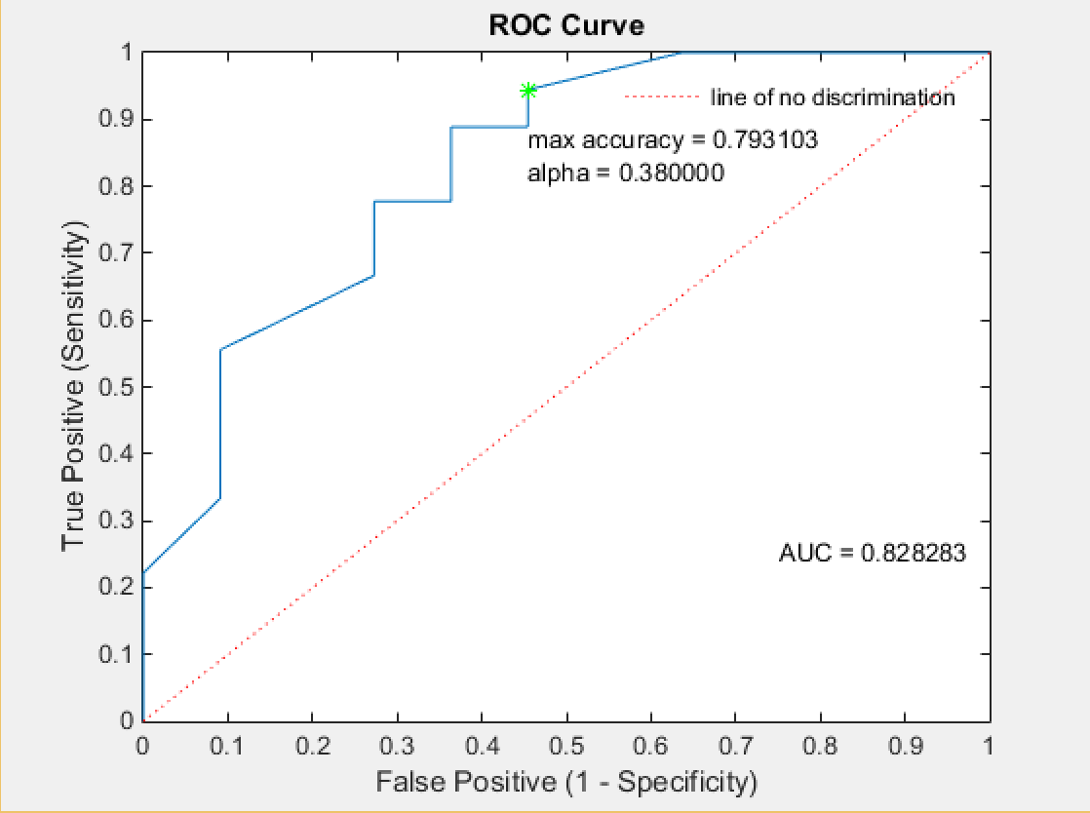
Static Model
Covariates: Age^0.001, Sex, Age*Sex
Age, sex thought to be physiologically useful
Power law used, exponent determined empirically
-emphasizes younger ages, due to concavity of function

Slide 10
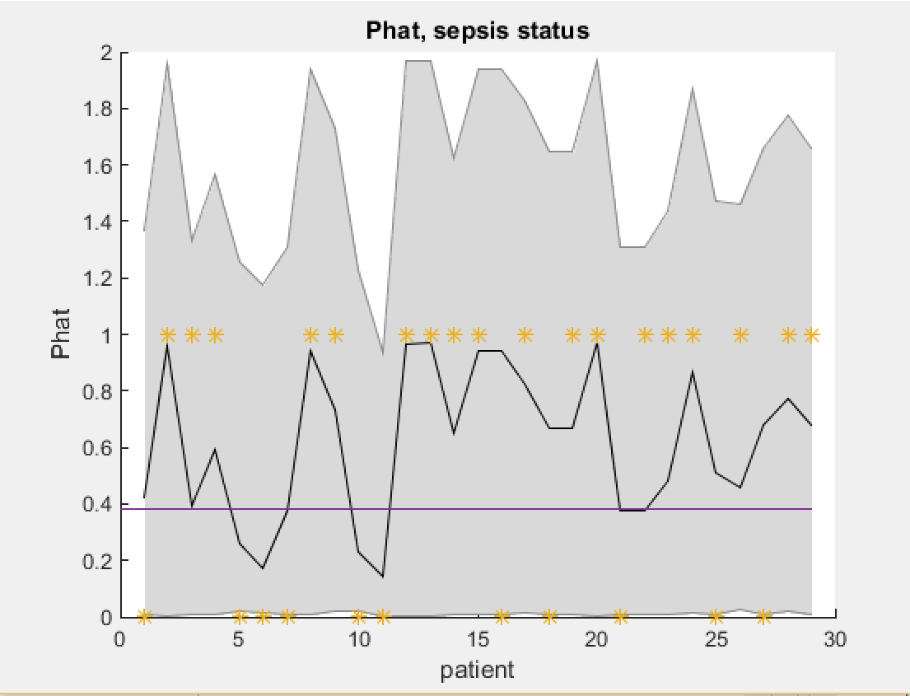
Static Model Performance
CI for P_hat very wide
Phat follows septic status, but loosely
Maximizing AUC, minimizing deviance and goodness of model fit doesn’t always lead to best model

Slide 11
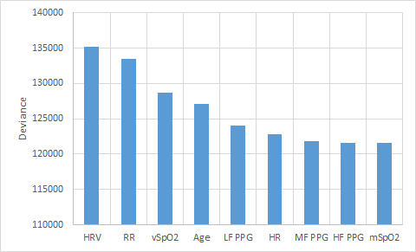
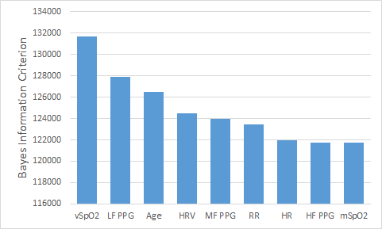
Parameter Selection
mSpO2

Slide 12
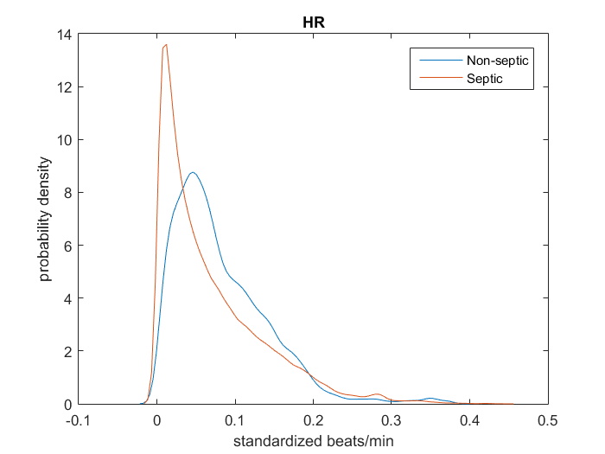
Heart Rate
Physiologically relevant; Part of the definition of sepsis diagnosis involves heart rate exceeding 90 bpm
Separation of Non-Sepsis and Sepsis
HOWEVER
Poor statistical fit (low effect on deviance, BIC) upon inclusion

Slide 13
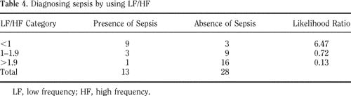
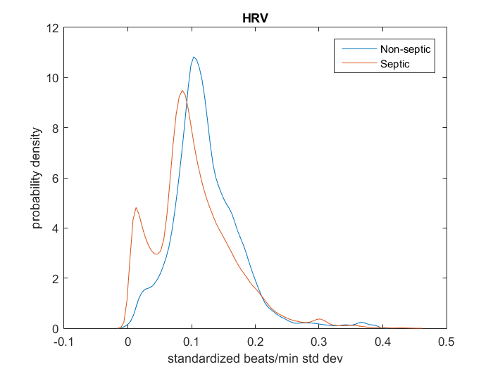
Heart Rate Variability
Autonomic nervous system shutdown
Highly ranked in all of our fitglm goodness of fit criteria
Studies done on ICU patients indicate that low HRV is highly correlated with presence of sepsis
Low frequency from Fourier Analysis is promising, but we lack resolution
Cardiac variability in critically ill adults: Influence of sepsis
Korarch et al

Slide 14
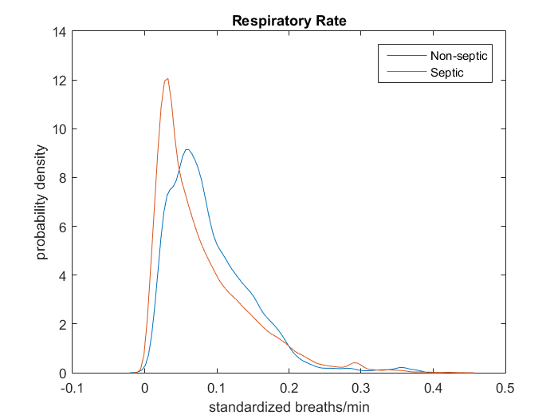
Respiratory Rate
Physiologically relevant; Part of the definition of sepsis diagnosis involves heart rate exceeding 20 breaths per minute
Highly ranked in all of our fitglm goodness of fit criteria (statistically relevant)
Separation among sepsis and non-sepsis waveforms

Slide 15
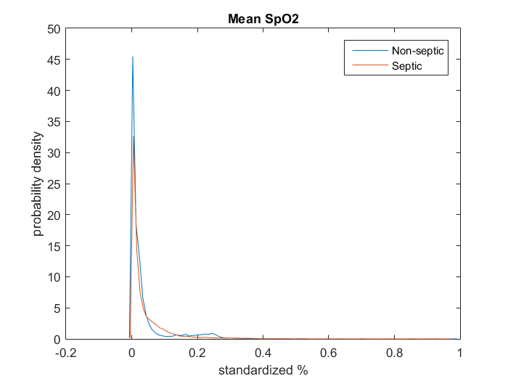
Mean of SpO2
Extremely poor separation in our patient waveforms
Poor statistical fit
Physiologically, SpO2 measurements can be confounded by hypoxemia, other symptoms from sepsis
Wilson, Ben J, Hamish J Cowan, Jason A Lord, Dan J Zuege, and David A Zygun. "The Accuracy of Pulse Oximetry in Emergency Department Patients with Severe Sepsis and Septic Shock: A Retrospective Cohort Study." BMC Emergency Medicine BMC Emerg Med: 9. Print.

Slide 16
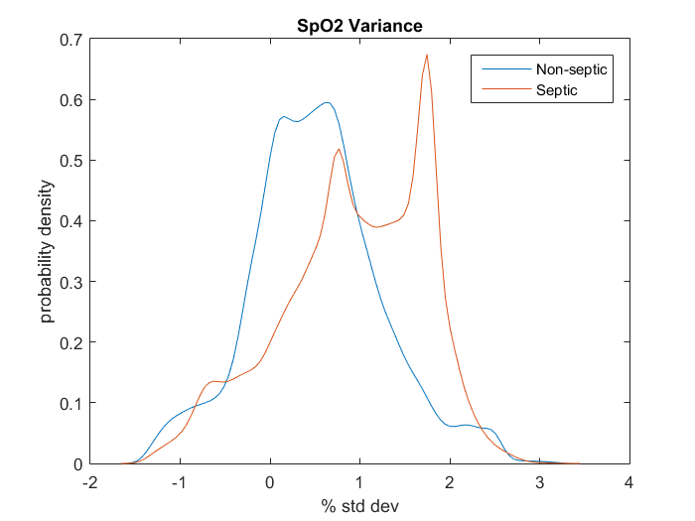
Variance of SpO2
Physiologically relevant; Variance of SpO2 is loosely correlated with heart rate variance (autonomic NS failure)
Highly ranked in all of our fitglm goodness of fit criteria (statistically relevant)
Excellent separation

Slide 17
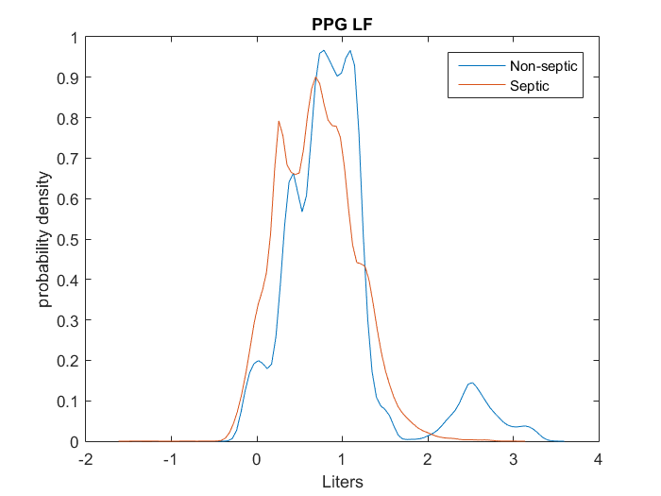
Low-frequency power of PPG
Measure of autonomic PPG control
Reduced LF components of the variability of cardiovascular signals are characteristic of septic shock, confirming the presence of abnormal autonomic control.
Resolution of high values
Piepoli et al (1995)

Slide 18
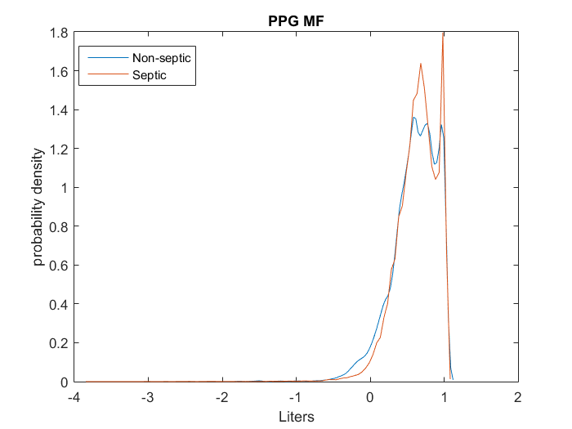
Mid-frequency power of PPG
Measure of hemostatic pressure control
Previous results supported use of MF PPG, similar to LF PPG
“The normalised MF power in Ear-PPG was significantly reduced in severe sepsis patients with hyperlactataemia (lactate[2 mmol/l), compared to SIRS patients (P<0.05).”
However, data was not resolvable, and this parameter was included late in our sequential model
Middleton et al (2010)

Slide 19
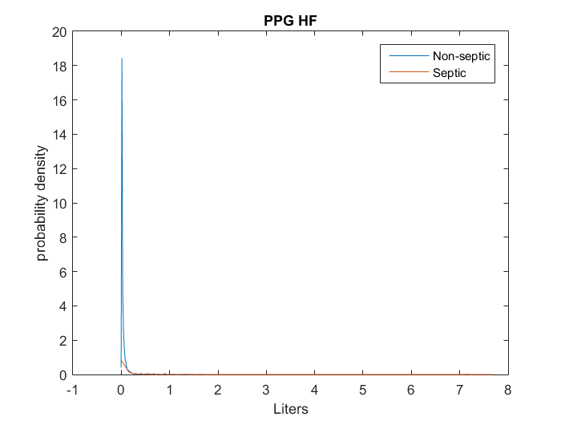
High-frequency power of PPG
Measure of PPG fluctuation due to respiratory patterns
“High power PPG increased in septic patients, but without statistical significance”
Increase is to compensate for decrease in LF, MF PPGs due to loss of autonomic control
Some link to respiration (not correlated due changes occuring nonsimultaneously)
Middleton et al (2010)

Slide 20
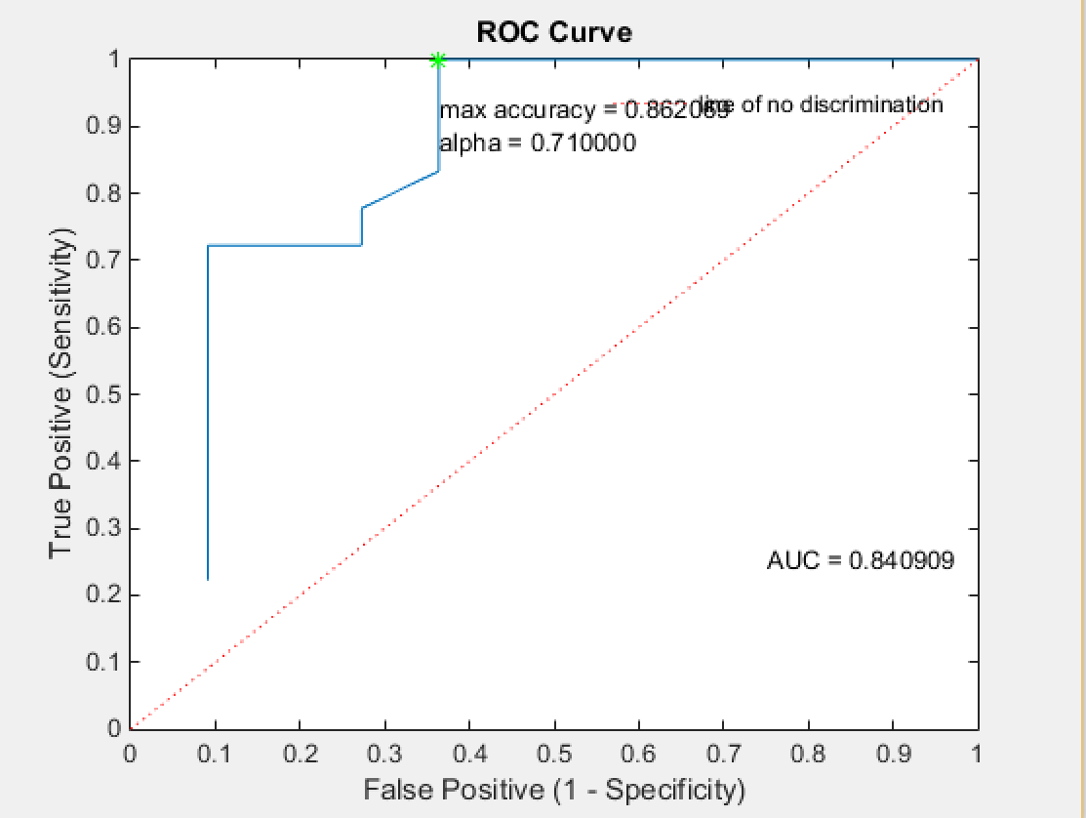
Dynamic Model
Covariates: Age, HRV, RR, variance (SpO2), LF PPG, and combination of Age:HRV, Age:LF PPG
logit(p) = BX
X is waveforms and product of waveforms
Interactions between sets of data: only two most important were included
Sepsis classification kept in timepoints
Percent correct with training data: 86%

Slide 21
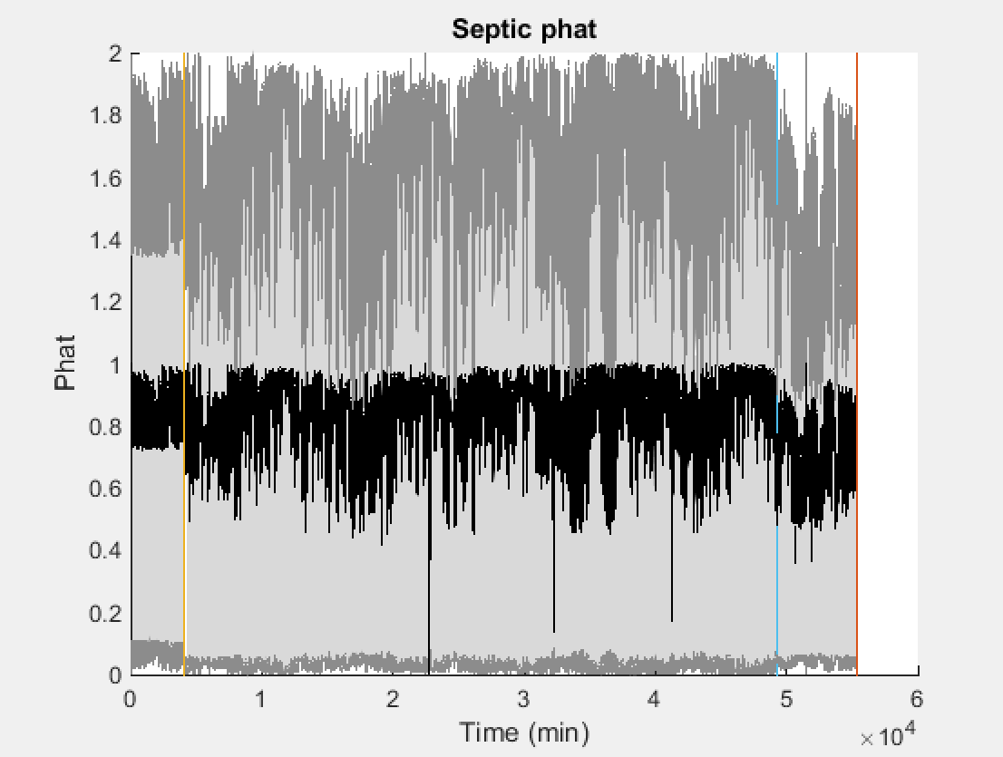
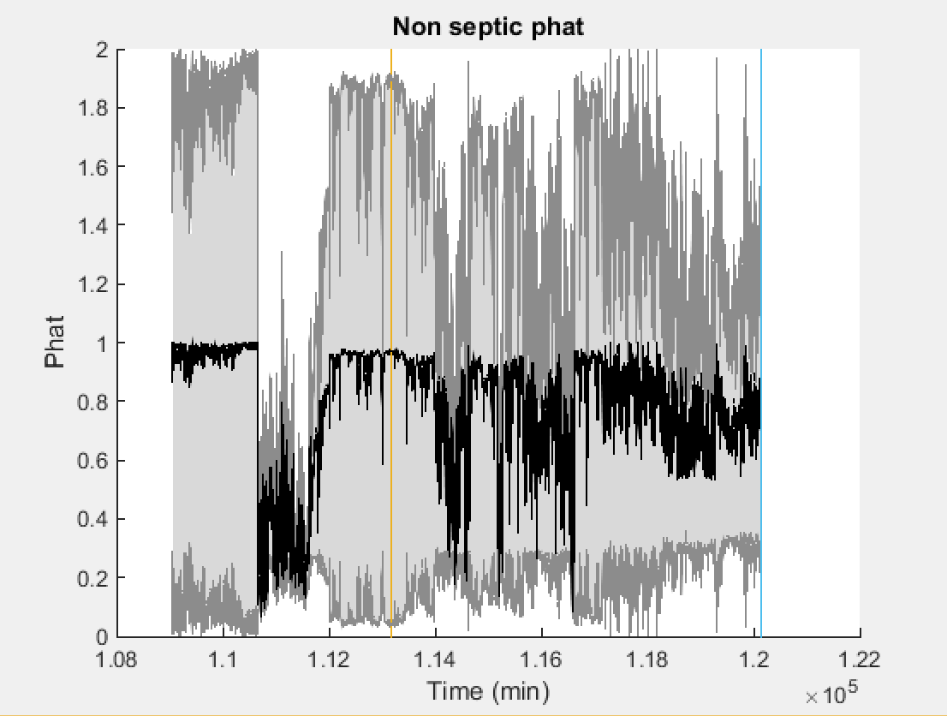
P_Hat for the Dynamic Model
Non-septic vs septic is differentiable
CI is very wide (threshold around 0.6)

Slide 22
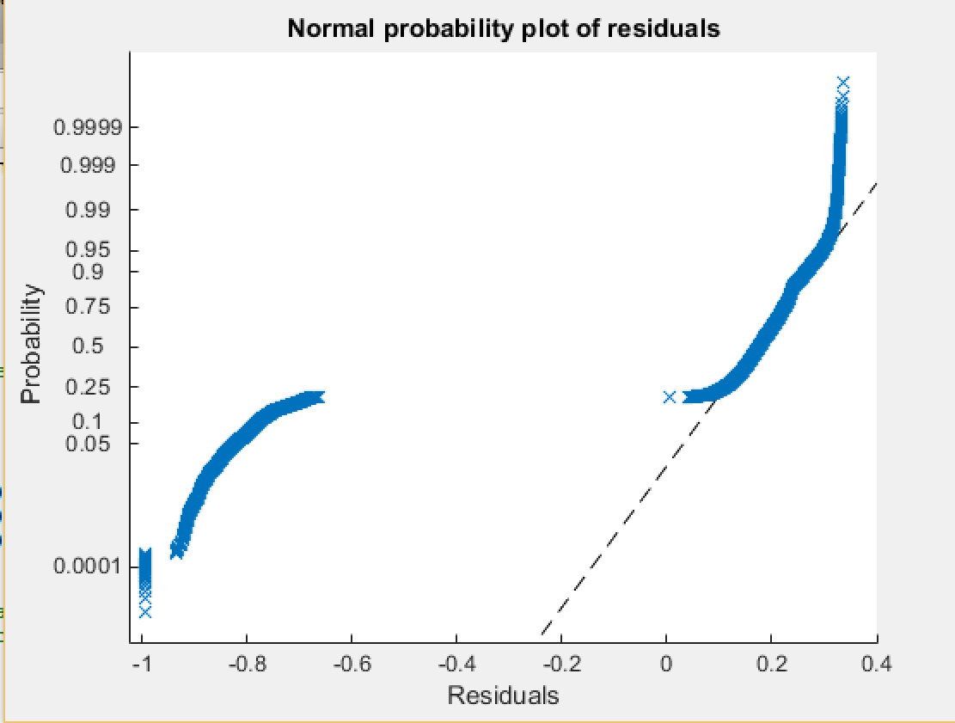
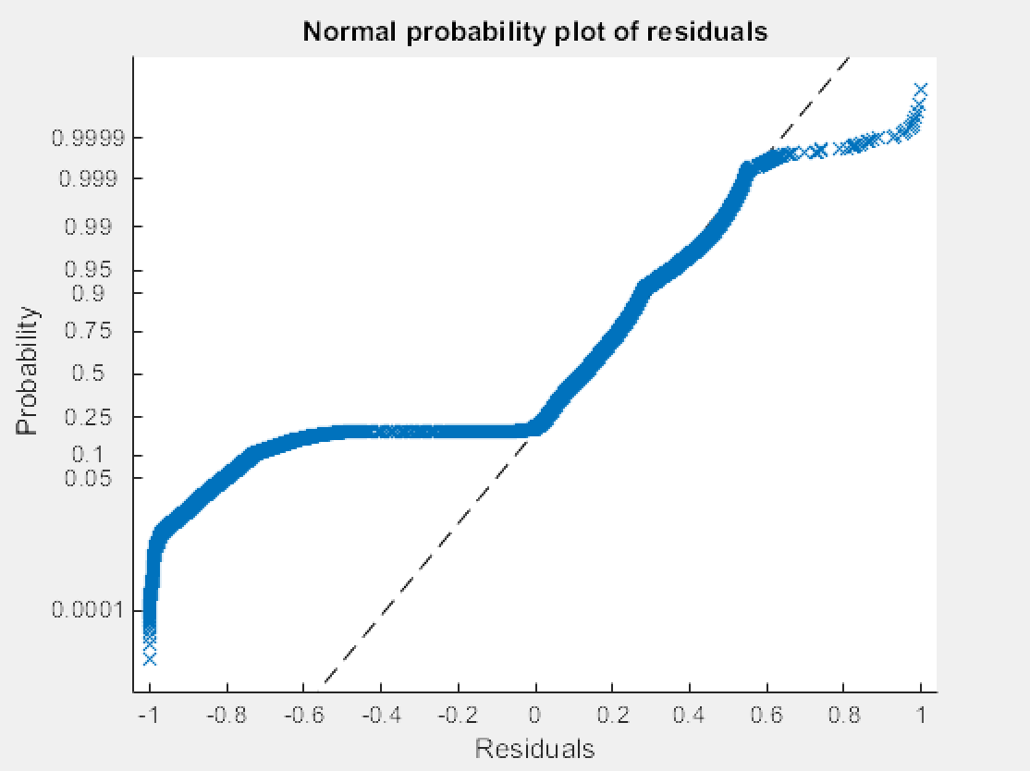
Performance of Dynamic Model
Residual plot excluding interactions Residual plot including interactions

Slide 23
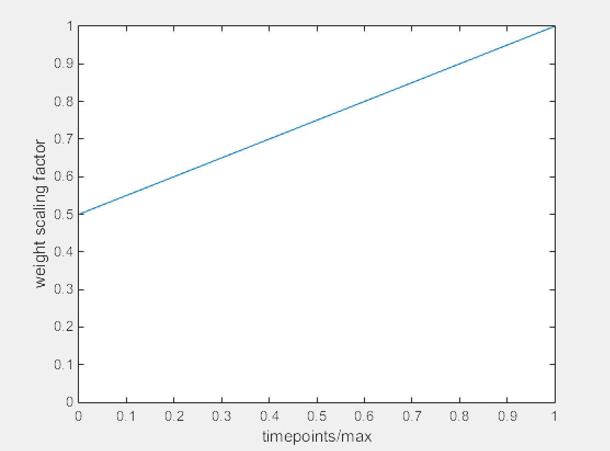
Future Directions
Very high sensitivity, low specificity:
Patients disproportionately weighted by data length
Extrapolate data for patients with less
Not implemented due to time constraints
Weight scaling curve

Slide 24
Citations
Piepoli, M., Garrard, C., Kontoyannis, D., & Bernardi, L. (1995). Autonomic control of the heart and peripheral vessels in human septic shock. Intensive Care Med Intensive Care Medicine, 112-119.
Middleton, P., Tang, C., Chan, G., Bishop, S., Savkin, A., & Lovell, N. (2010). Peripheral photoplethysmography variability analysis of sepsis patients. Med Biol Eng Comput Medical & Biological Engineering & Computing, 337-347.
Wilson, Ben J, Hamish J Cowan, Jason A Lord, Dan J Zuege, and David A Zygun. "The Accuracy of Pulse Oximetry in Emergency Department Patients with Severe Sepsis and Septic Shock: A Retrospective Cohort Study." BMC Emergency Medicine BMC Emerg Med: 9. Print.

